Slide 1
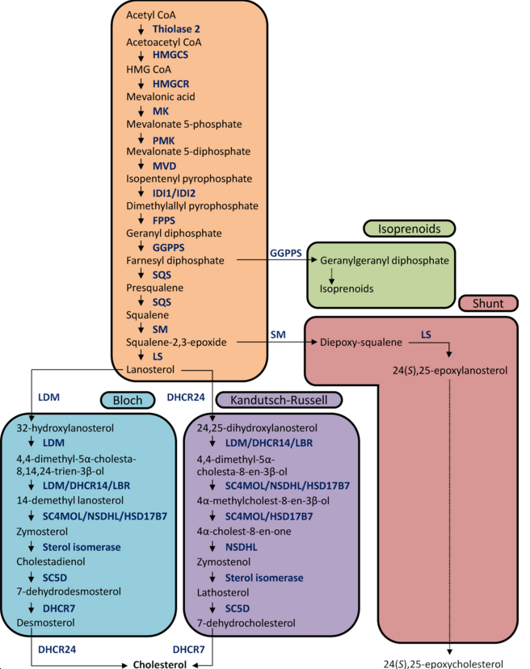
* Mouse 6-mer
MiR-7 targets Cholesterol synthesis
* Mouse 7-mer-A1
* Mouse 7-mer-8
* Mouse 8-mer
* Human 6-mer
* Human 7-mer-A1
* Human 7-mer-8
* Human 8-mer
*
*
***
*
*
*
SC4MOL=DESP4=MSMO1
*
*
*
*
*
*
* 5
* 2
*

